Slide 1

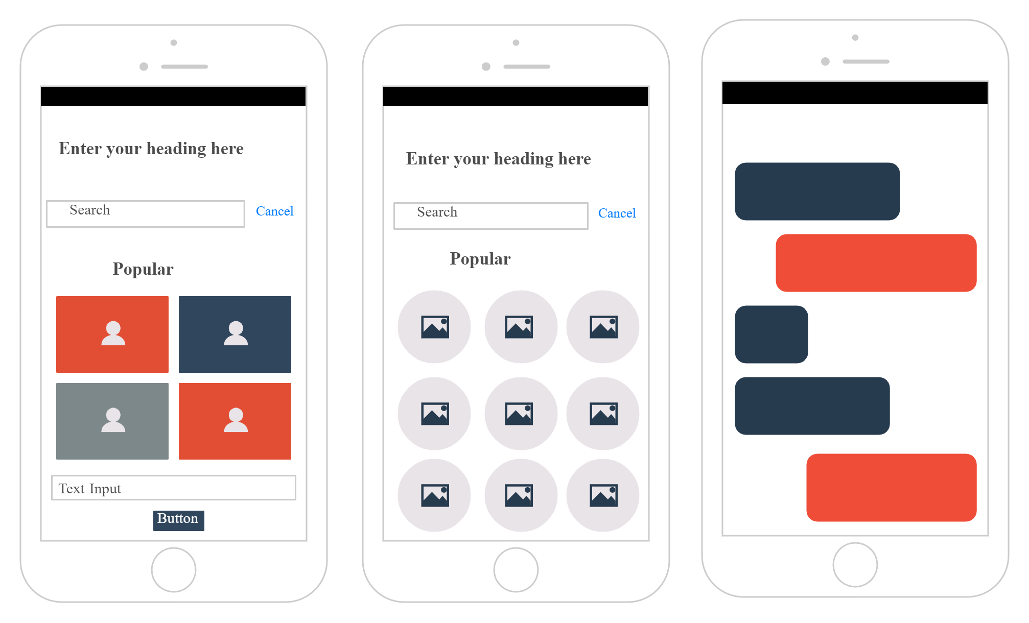
MOCKS
A mockup is a static wireframe that includes more stylistic and visual UI details to present a realistic model of what the final page or application will look like. A good way to think of it is that a wireframe is a blueprint and a mockup is a visual model.

Slide 2
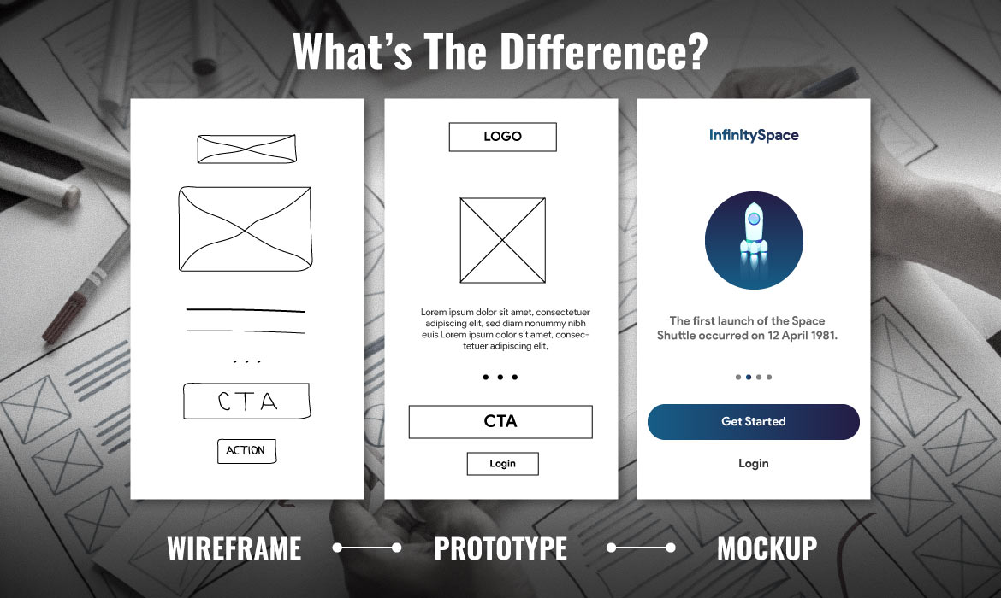
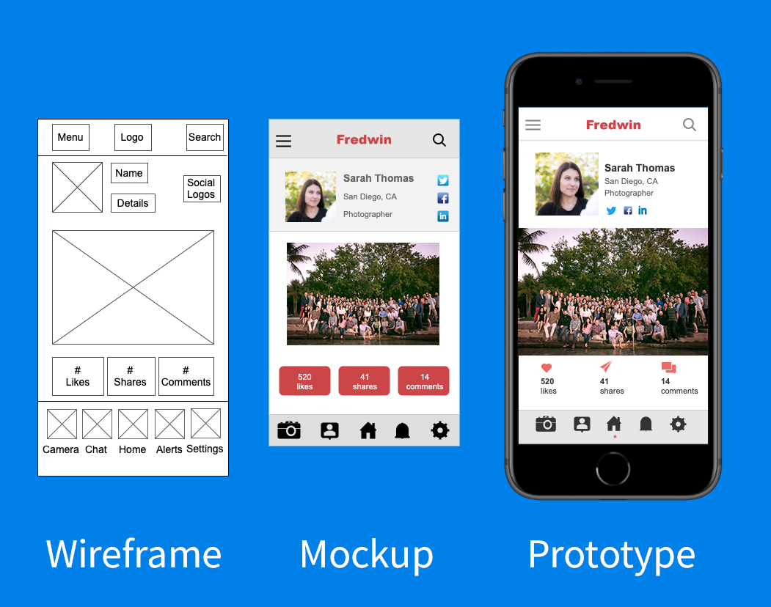
EXAMPLES OF MOCKS

